Slide 1

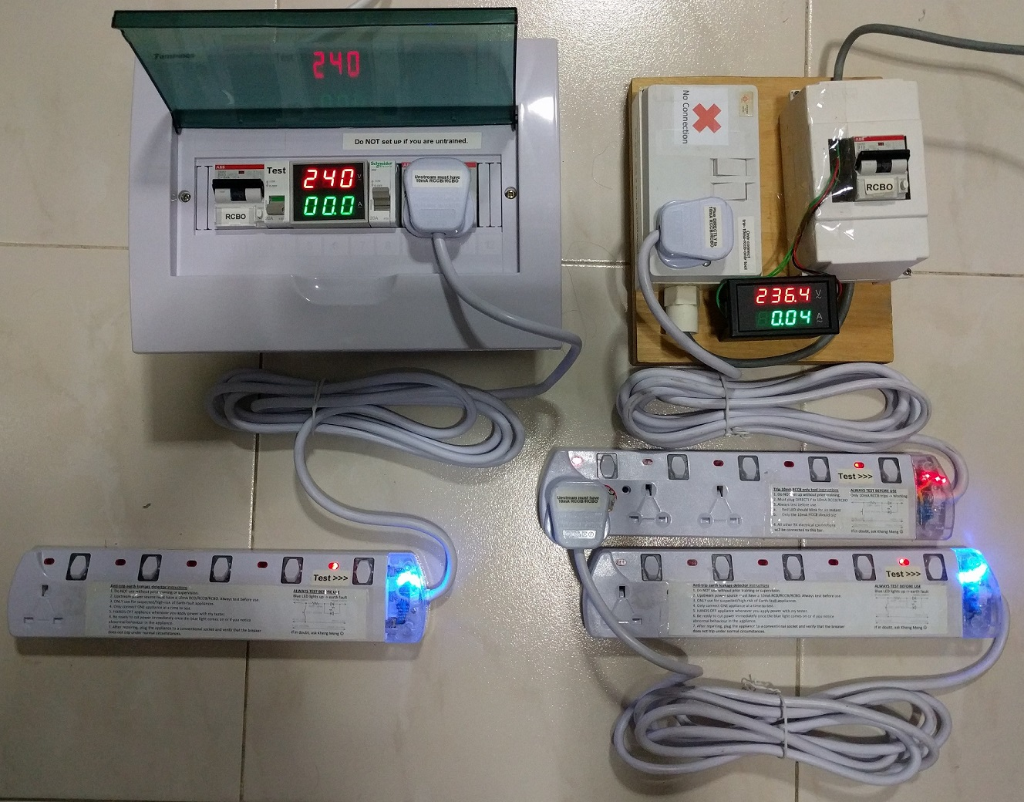
Repair Kopitiam Specialty Electrical Equipment
By: Yeo Kheng Meng (yeokm1@gmail.com)
http://yeokhengmeng.com/2016/05/repair-kopitiam-speciality-electrical-tools/
https://github.com/yeokm1/repair-kopitiam-training-and-equipment
Hackware v2.0 (27 July 2016)

Slide 2

Background
Sustainable Living Lab (SL2)
Social Enterprise
Aims to build a Sustainable Future through community building, technology experimentation and social innovation.
http://www.sl2square.org/
Repair Kopitiam (RK)
Voluntary social initiative by SL2 began in Nov 2014
Combat the Buy-and-Throw-Away culture
Monthly event to guide residents to repair their items
Electrical appliances, fabrics, home improvement
Repair Coaches and not repairmen
http://repairkopitiam.sg/

Slide 3
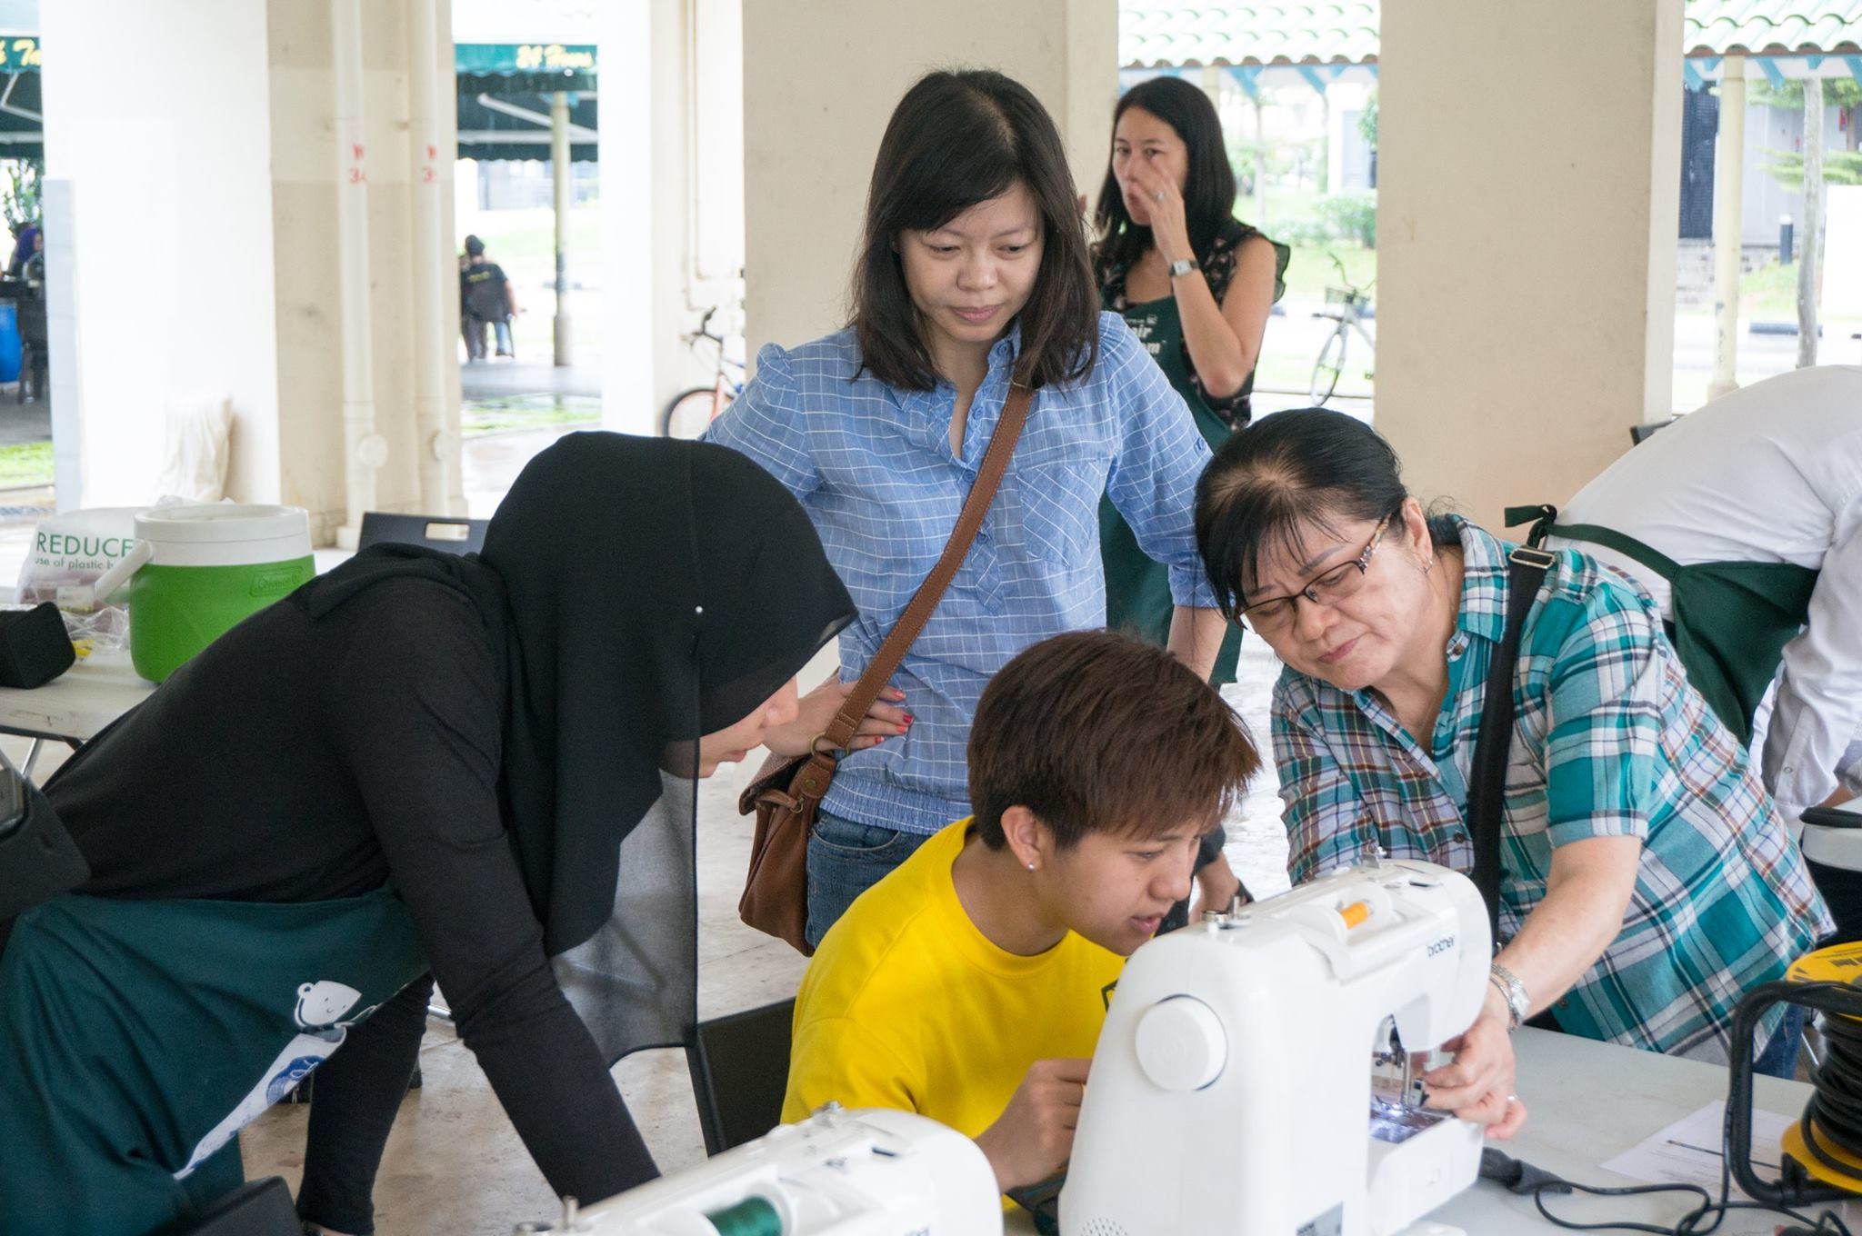


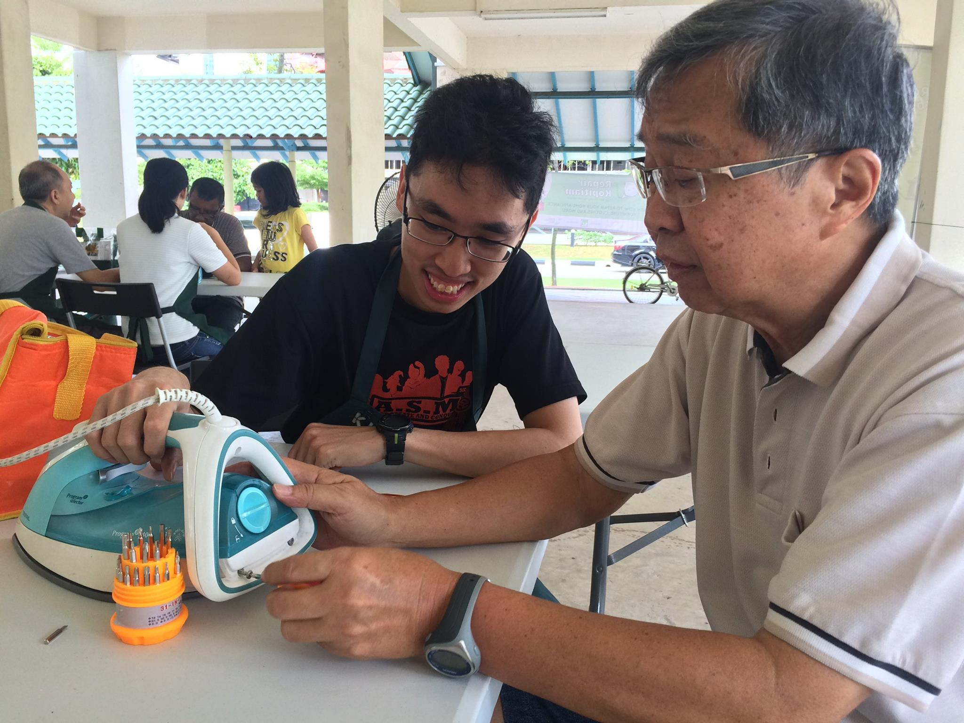
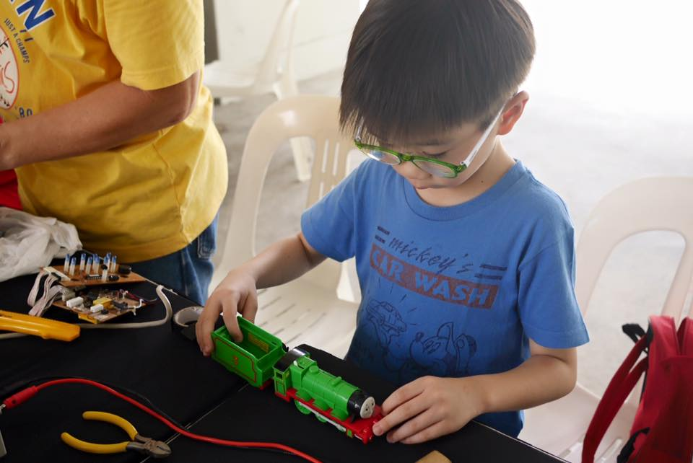
Photos

Slide 4
Agenda
Fundamental Knowledge
Problems
Solutions

Slide 5
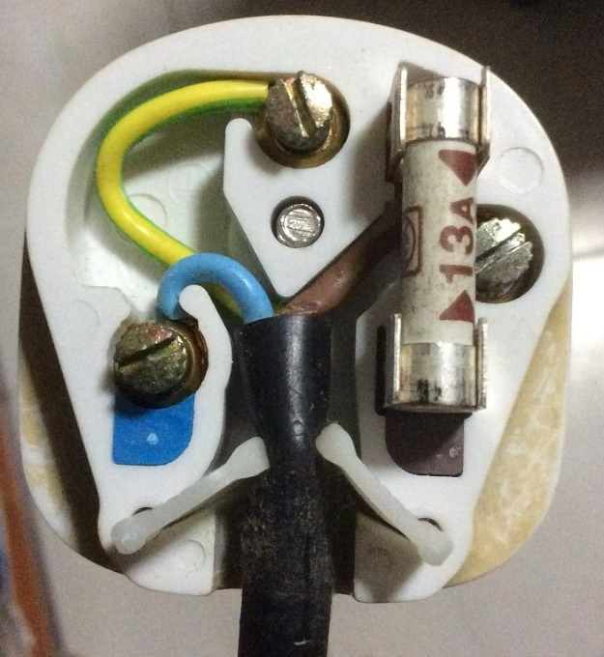
Inside the 3-pin mains plug (BS1363)
Earth
Yellow/Green
Connects to appliance’s external case, protects user from electric shock
Fuse
Blows on overcurrent
Usually 13A
Neutral
Blue/Black
Completes the circuit to generator
Tied to ground at power distribution box to ensure stable 0V
Live
Brown/Red
Source of power

Slide 6
Earth connections: Normal operation
Kettle
Mains Live
Fuse
240V
AC ~
Mains Neutral
Mains Earth
Earth

Slide 7
Live wire touches case
X
Kettle
Mains Live
Fuse
240V
AC ~
Mains Neutral
Mains Earth
Earth

Slide 8
What if there is no Earth wire?
Fuse does not blow due to human-body resistance
Kettle
Mains Live
Fuse
240V
AC ~
Mains Neutral
Earth

Slide 9
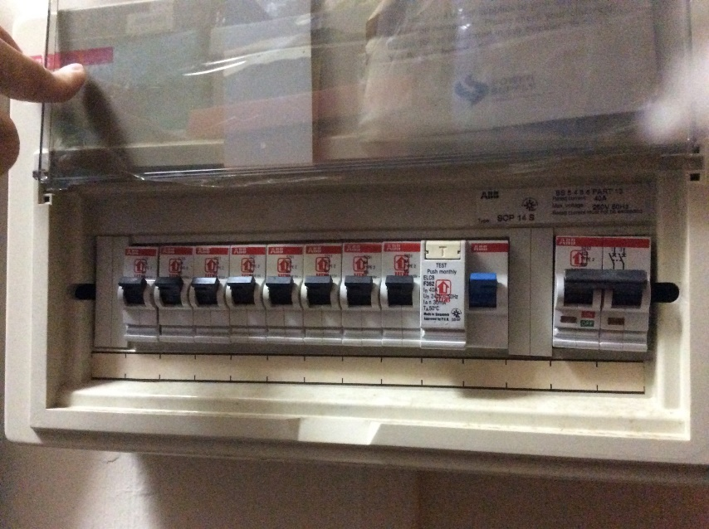
Circuit Breakers
MCB
RCCB
Miniature Circuit Breakers (MCBs)
What it does?
Breaks the circuit on overcurrent eg. short circuit
Residual Current Circuit Breaker (RCCB)
What it does? Breaks the circuit on earth fault
Cause: Current leakage via Earth wire or human electrocution
When?: Breaks when current difference between live neutral > threshold (usually 30mA)

Slide 10
Circuit breaker arrangement
Mains Live
Kettle
MCB
RCCB
Fuse
240V
AC ~
Mains Neutral
Mains Earth
Earth
Residual Current Circuit Breaker (RCCB)
What it does? Breaks the circuit on earth fault
Cause: Current leakage via Earth wire or human electrocution
When?: Breaks when current difference between live neutral > threshold (usually 30mA)
Miniature Circuit Breakers (MCBs)
What it does?
Breaks the circuit on overcurrent eg. short circuit

Slide 11
Residual Current Circuit Breaker with Overload Protection (RCBO)
Mains Live
Kettle
RCBO
Fuse
240V
AC ~
Mains Neutral
Mains Earth
Earth
RCBO = RCCB + MCB

Slide 12
Problems
Safety
Inaccessible onsite breaker
Inconvenience of breaker trip

Slide 13
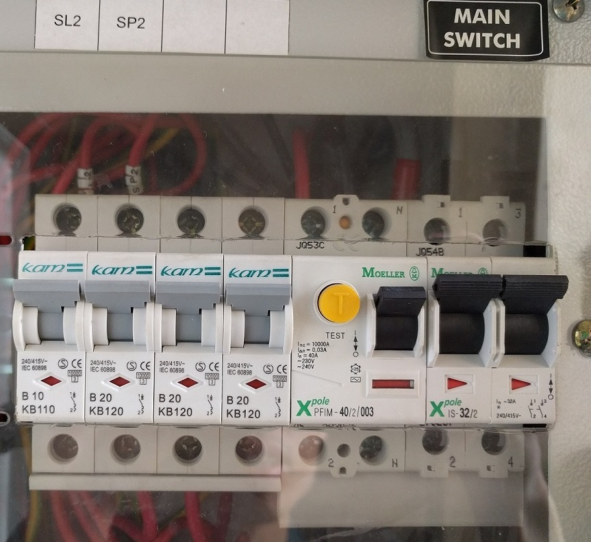
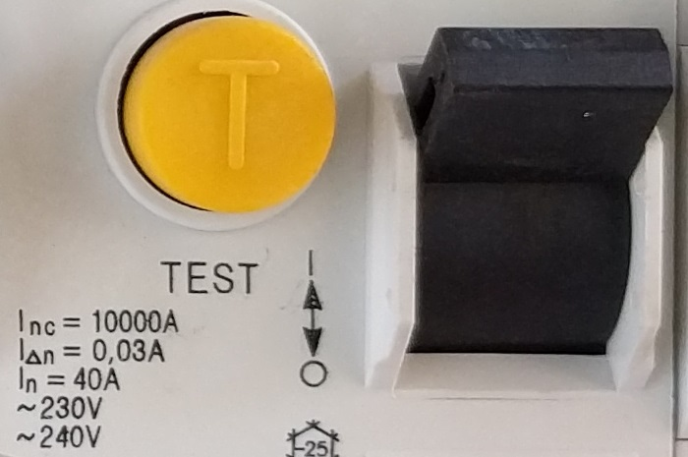
Problem 1: Safety
Typical I_{△n} = 30ma threshold for earth leakage
Balance between safety and nuisance trips
But RK always deals with high-risk faulty appliances…

Slide 14
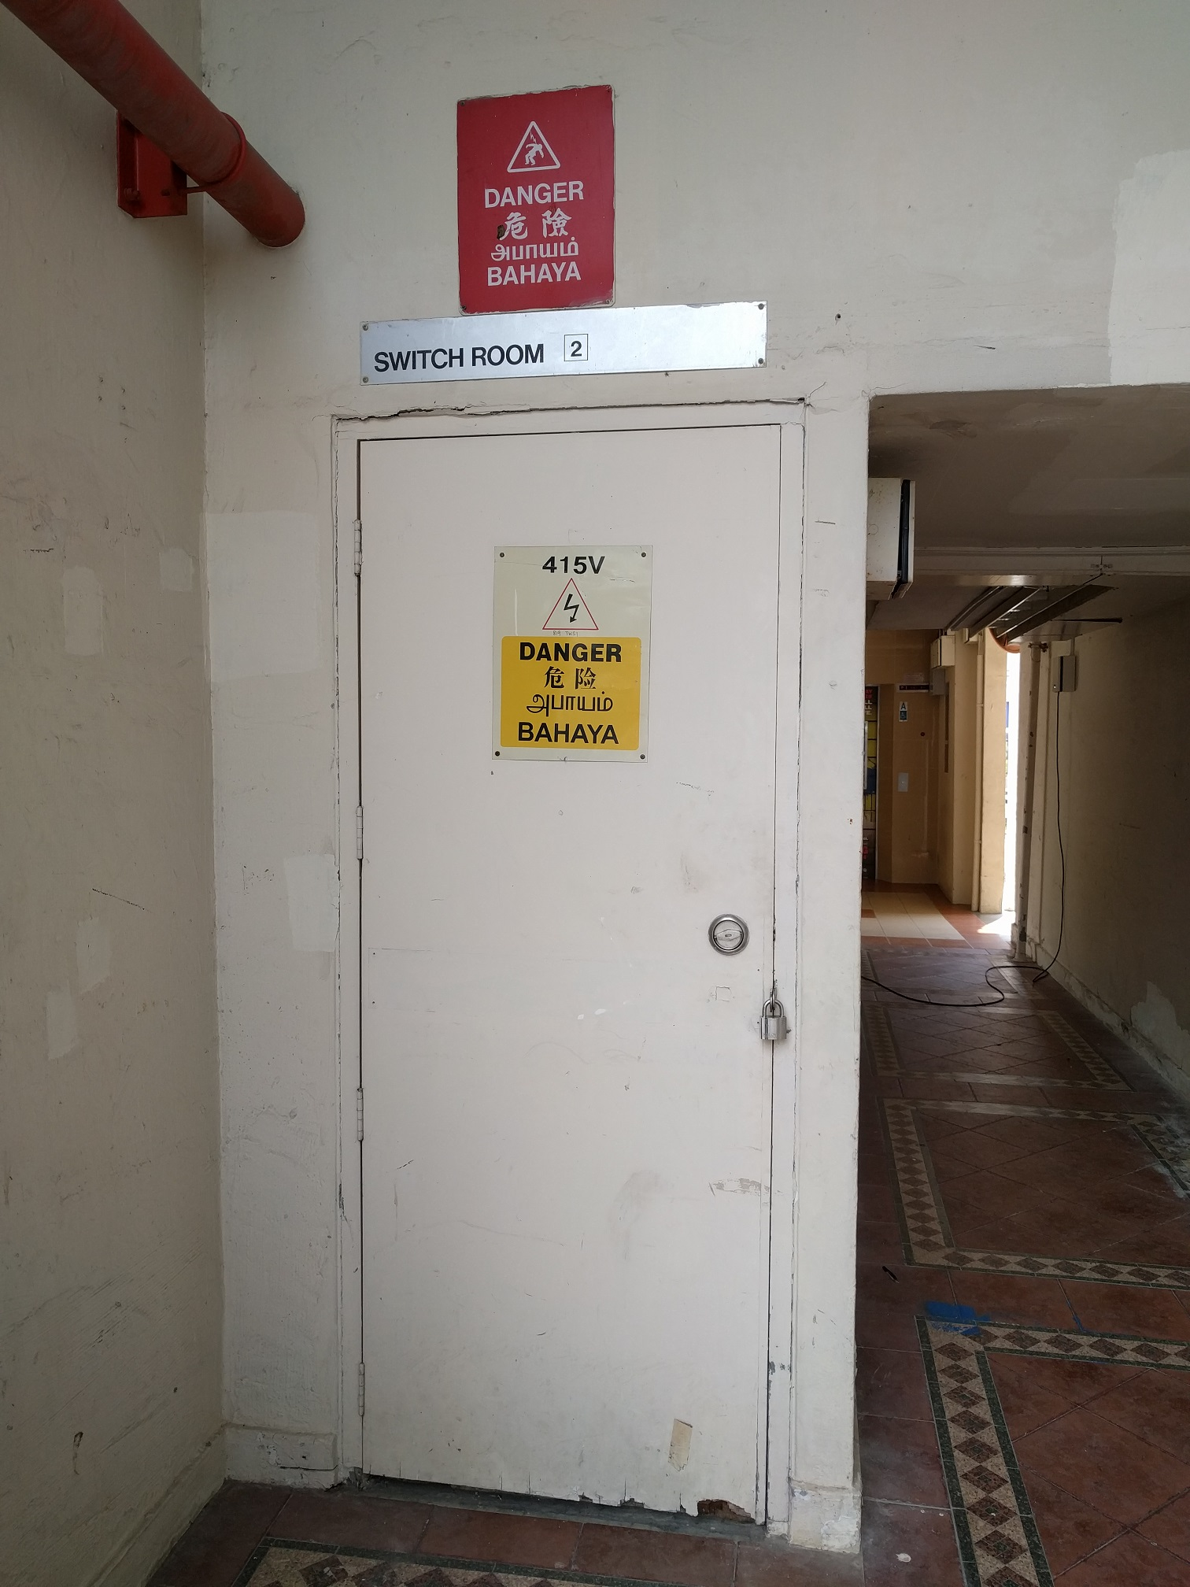
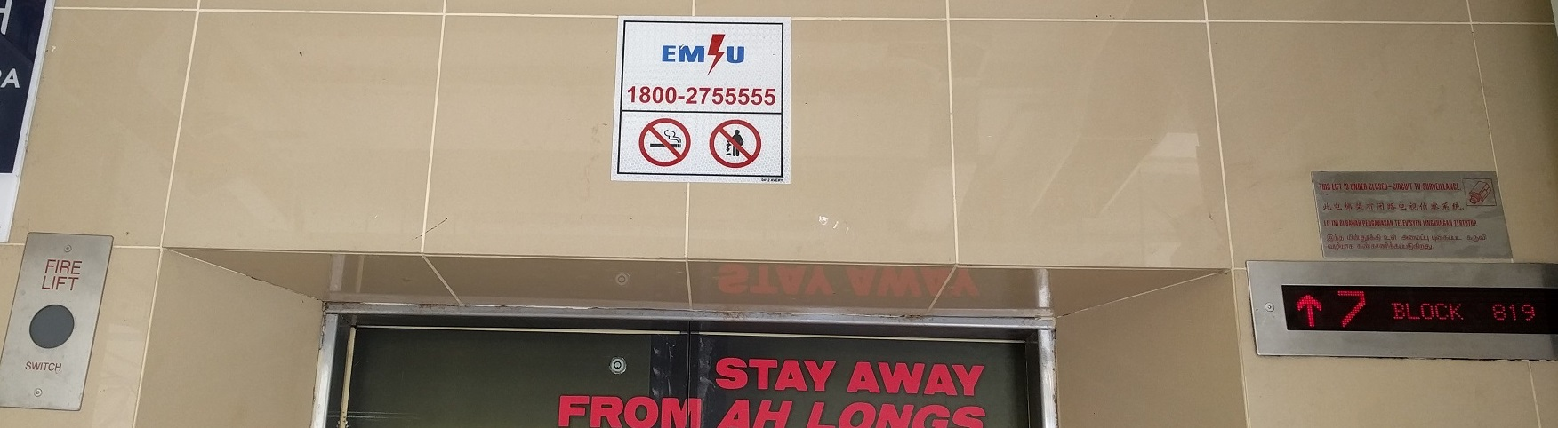
Problem 2: Inaccessible onsite breaker
Circuit breaker inside locked electrical room
Access to electrical room requires calling Essential Maintenance Service Unit (EMSU)
75 mins response time

Slide 15
Problem 3: Inconvenience of breaker trip
Breaker trips affect the work of others
Eg. Those using sewing machines and welding

Slide 16
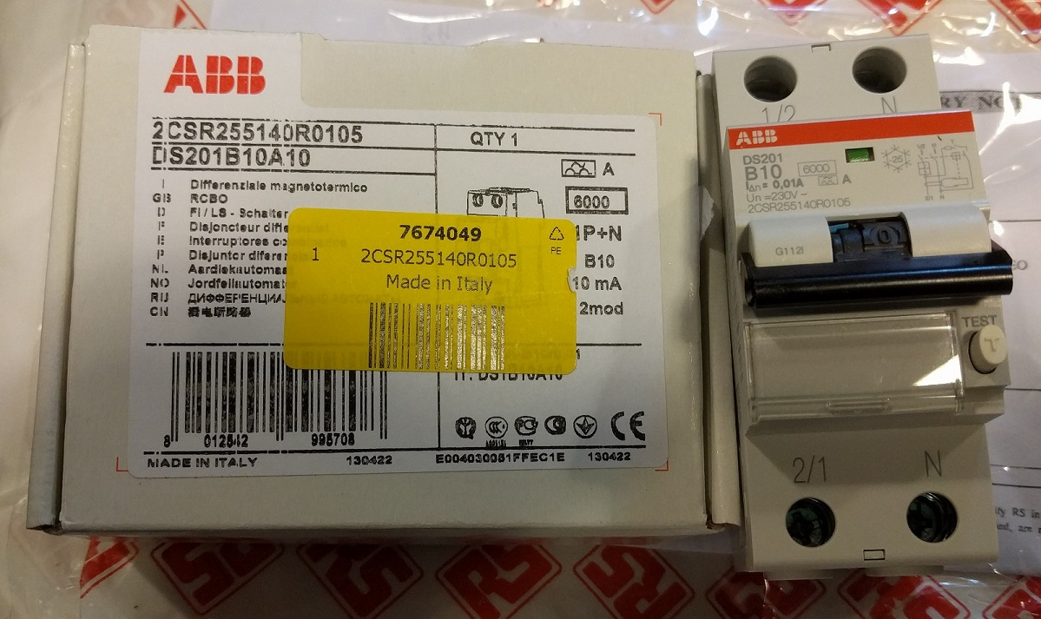
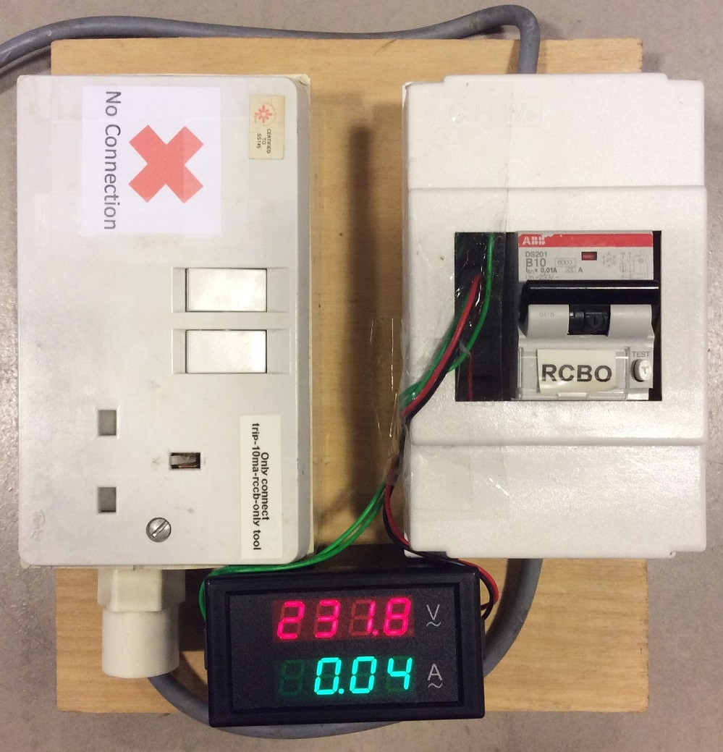
Solution 1 for safety problem
A more sensitive circuit breaker
RCBO with I_{△n} = 10mA sensitivity
ABB DS201 B10 A10
Installed with multi-meter to monitor line voltage/current
Ammeter helps to detect appliances which use high currents

Slide 17
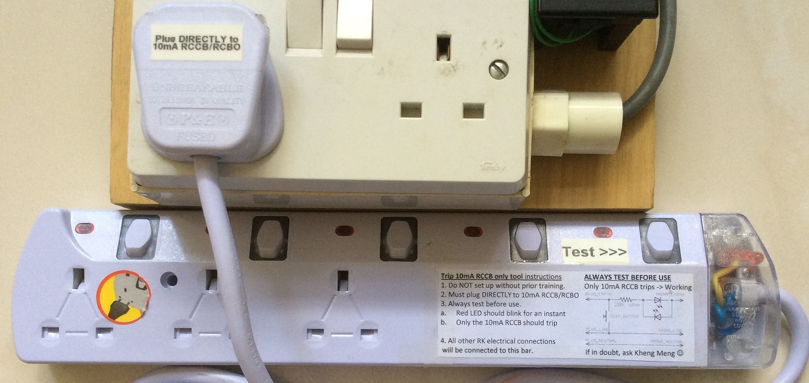
Solution 2 for inaccessible circuit breaker
Goals:
Prevent the onsite 30mA circuit breaker from tripping
BUT still maintain safety by tripping our 10mA RCBO
trip-10ma-rccb-only-tool modified from power strip

Slide 18
Demo video of trip-10ma-rccb-only-tool
Open trip-10ma-rccb-only-tool.mov
https://www.youtube.com/watch?v=OAcWiW7V_oI

Slide 19
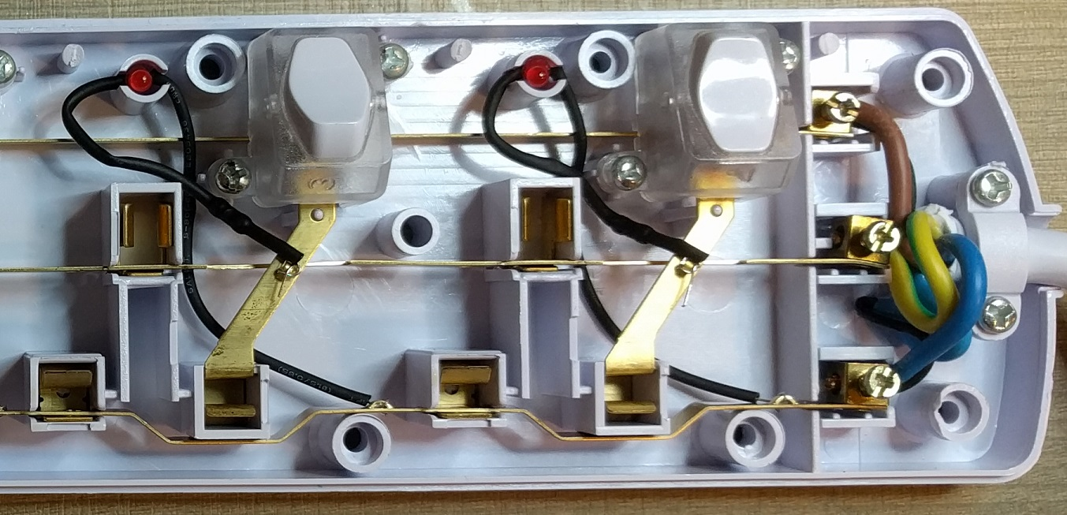
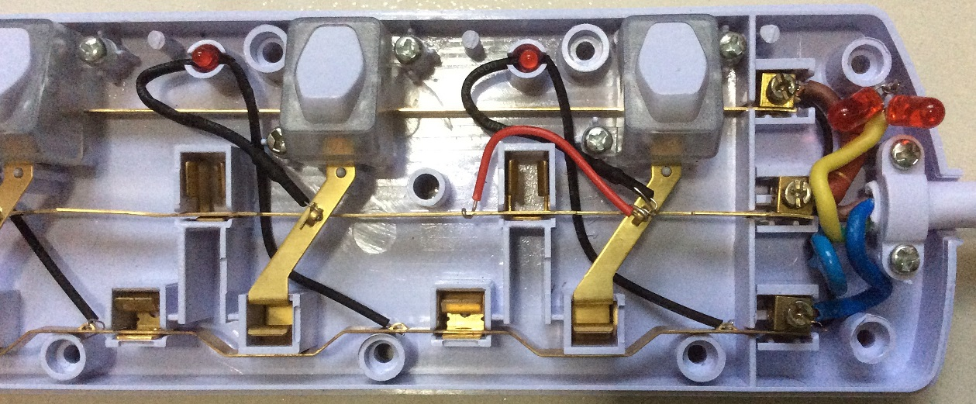
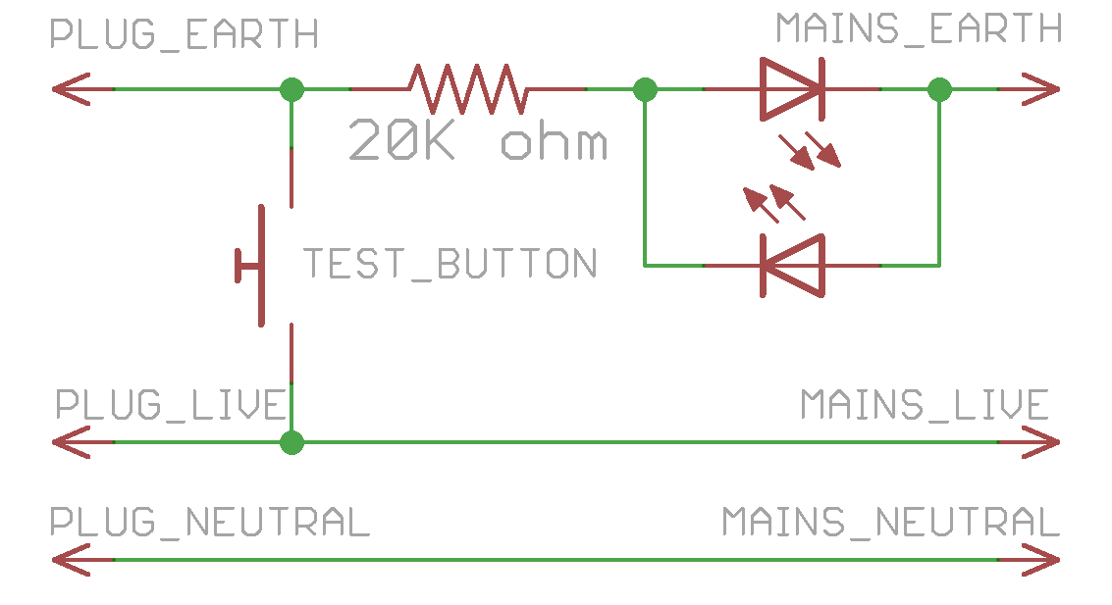
Design of trip-10ma-rccb-only-tool
Before
After
20K Ω resistor on Earth line
Rightmost socket switch as test button

Slide 20
Why 20K ohm resistor?
Goal: Trip our 10mA breaker and not onsite’s 30mA one
Trip margin can be 50% of rated: 15mA
So earth current must be < 15mA, we start with 14mA
Voltage (V) = Current (I) x Resistance (R)
-> R = V / I
R = 240 / 0.014 ≈ 17K Ω
But tests indicate a breaker can trip still trip due to existing earth leakage
I finally settle with 20K Ω -> 12mA of leakage.

Slide 21
External breaker can still trip
There is an Earth-leakage via means other than the Earth wire
There is an overload in the circuit eg short circuit.
Overload Trip sensitivity of external breaker higher than ours

Slide 22
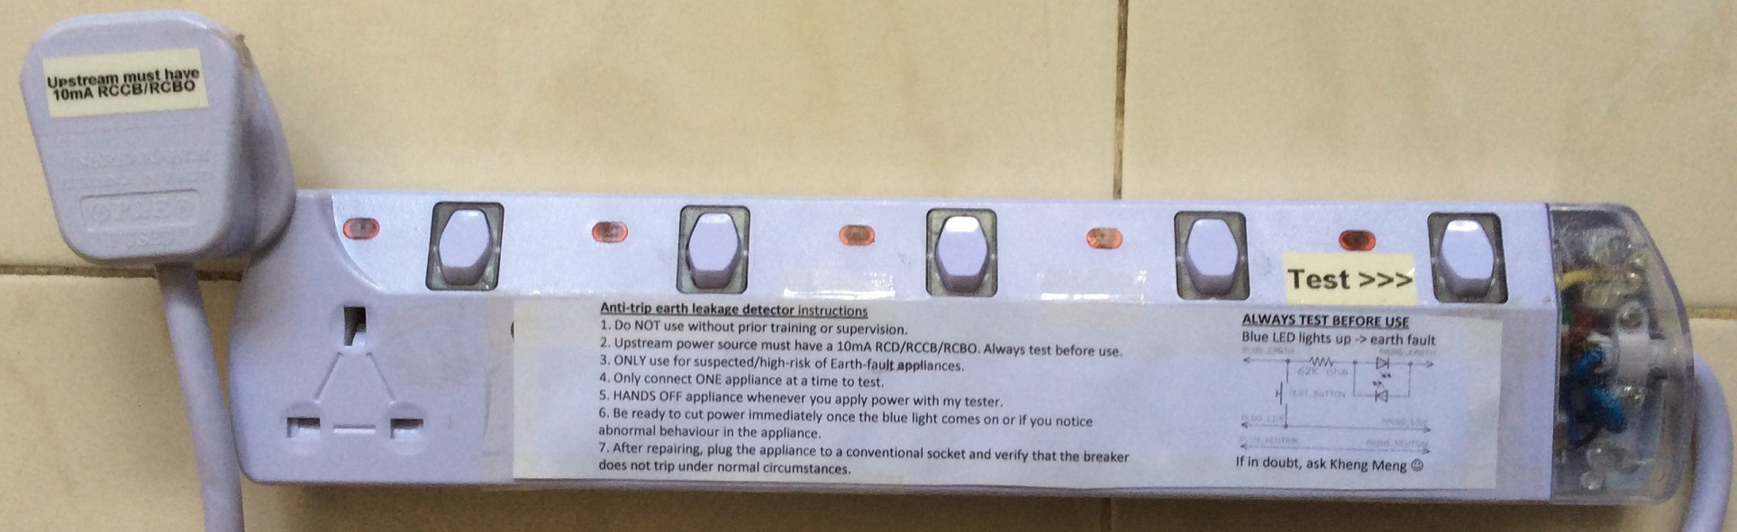
Solution 3 for inconvenience of breaker trip
Goals:
Prevent even 10mA circuit breaker trips to avoid interrupting others’ work
Bright LEDs to indicate earth leakage
anti-trip-earth-leakage-detector modified from power strip

Slide 23
Demo video of anti-trip-earth-leakage-detector
Open anti-trip-earth-leakage-detector.mov
https://www.youtube.com/watch?v=tSpie7baYFM

Slide 24
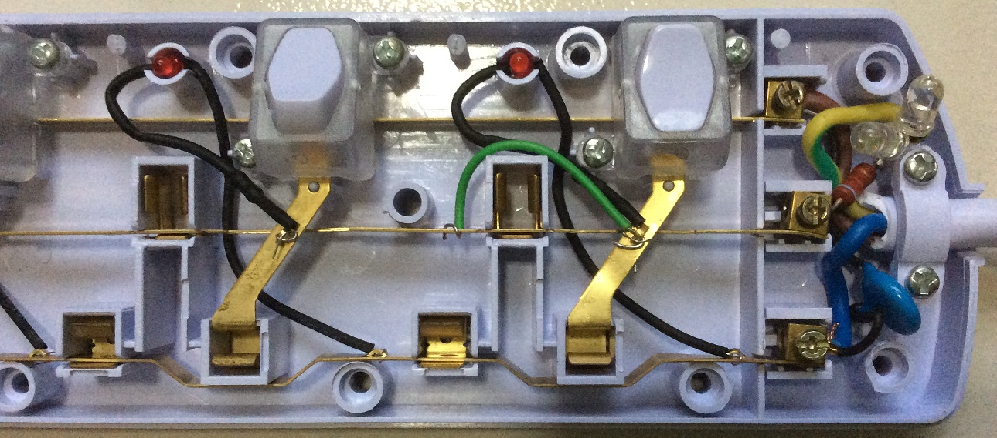

Design of anti-trip-earth-leakage-detector
Before
After
62K Ω resistor on Earth line
Bright 600mcd LEDs to display even at low current
Rightmost socket switch as test button

Slide 25
Why 62K ohm resistor?
Goal: Do not even trip our 10mA breaker
Trip margin can be 50% of rated: 5mA
So earth current must be < 5mA, we start with 5mA
Voltage (V) = Current (I) x Resistance (R)
-> R = V / I
R = 240 / 0.005 ≈ 48K Ω
So resistance > 48K Ω
I finally settle with 62K Ω -> 3.87mA of leakage.

Slide 26
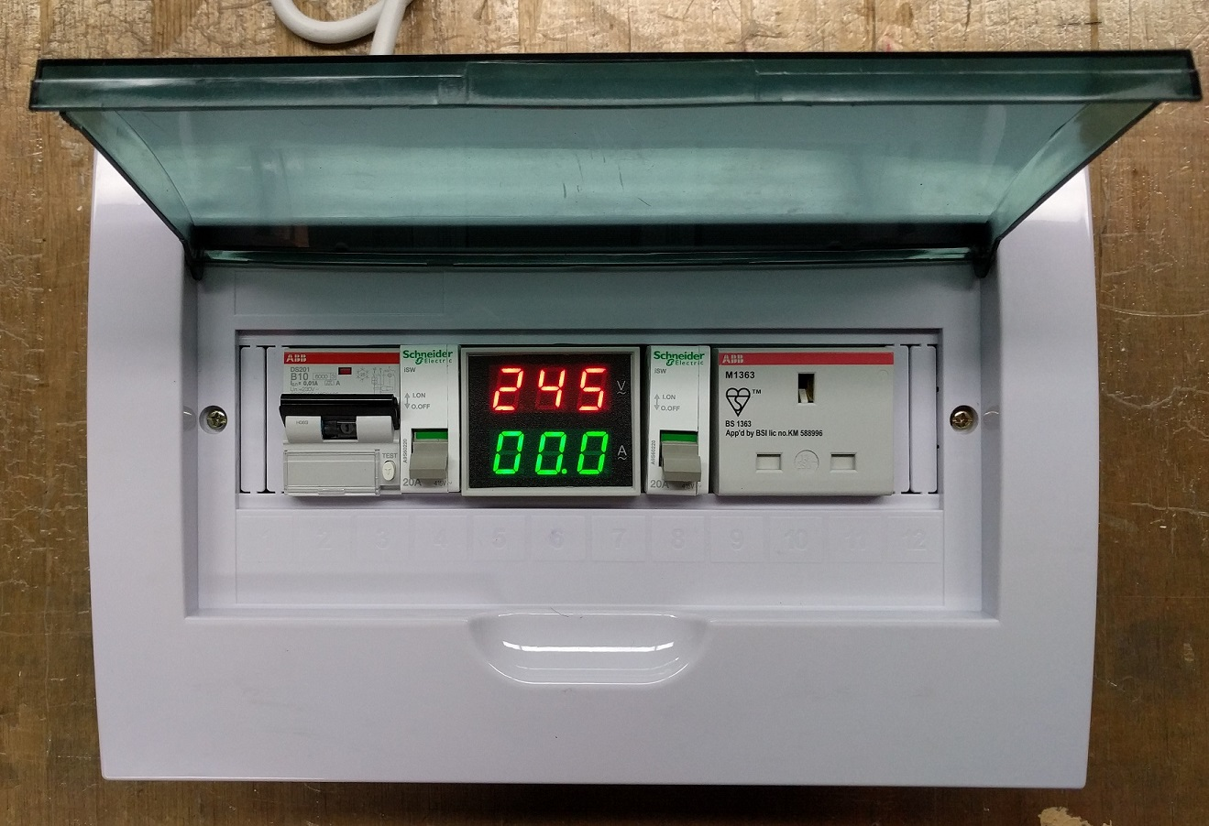
Solution 4: Solution 1 + Solution 2
10mA RCBO + trip-10ma-rccb-only-tool
10ma-rcbo-and-anti-external-cb-trip

Slide 27
Demo video of 10ma-rcbo-and-anti-external-cb-trip-with-anti-trip-earth-leakage-detector
Open 10ma-rcbo-and-anti-external-cb-trip-with-anti-trip-earth-leakage-detector.mov
https://www.youtube.com/watch?v=h-DokWP5Kic

Slide 28
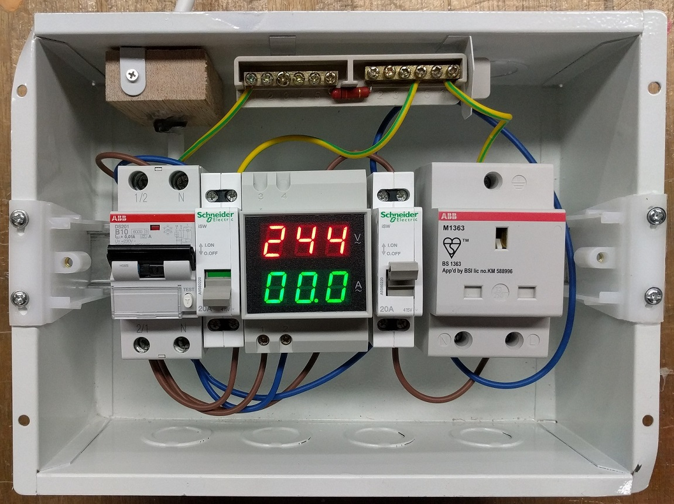
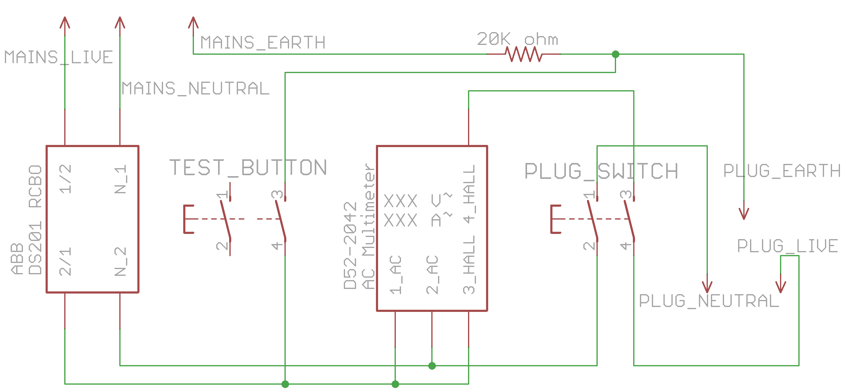
Design of Solution 4

Slide 29
Next Repair Kopitiam
Every last Sunday of the month
10am to 3pm, Sunday 31 July 2016
Locations:
Block 425 Jurong West Ave 1
Block 819 Tampines Street 81
https://www.facebook.com/repairkopitiam/
FB Group on Repair Advice and queries
Love Your Barang? Fix Your Barang! By Repair Kopitiam
https://www.facebook.com/groups/1611578529156041/
New volunteers WELCOME!

Slide 30
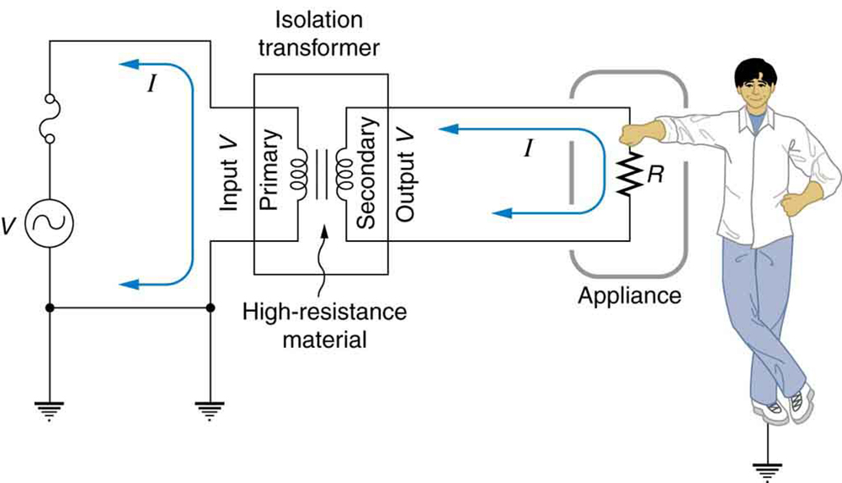
Why not an isolation transformer?
But first what is an isolation transformer?
An isolation transformer is a transformer used to transfer electrical power from a source of alternating current (AC) power to some equipment or device while isolating the powered device from the power source, usually for safety reasons. (Wikipedia)
Picture from: https://cnx.org/resources/d9a067d1533f2d80b43bec5d36470711ad71b34f/Figure_24_08_08.jpg

Slide 31
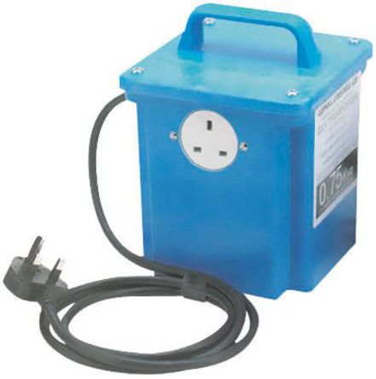
So why not use an isolation transformer?
Eg. Carroll & Meynell, 3kVA CM3000/230 Single 13A
Heavy: 18kg each
Hides earth faults since RCCB does not trigger
Can only use on one appliance at a time
240V Primary : 240V Secondary
Kettle 1
Kettle 2
240V
AC ~
1:1
Isol.
Trf.

